Slide 1
Causation: Logic models, DAGS, and Potential Outcomes
EDUC 7610 – Regression Analysis
Tyson S. Barrett, PhD

Slide 2
Seeking Causation
The majority of your research will likely be seeking causal relationships
What is causation then??

Slide 3
Causation
X causes Y if...
...when X changes (but nothing else changes)...
...Y changes.

Slide 4
Causation
X causes (“influences”) Y
X is unlikely to be the only cause of Y
Rain causes my lawn to get wet (but so do my sprinklers, my kids playing with the hose, etc.)

Slide 5
Which are causal?
Earning a graduate degree increases income?
Lightning causes thunder?
Tanning causes skin cancer?

Slide 6
More formal definition
We need to show three main things:
Correlation
X happens before Y
All other factors ruled out

Slide 7
Logic Models
A representation of what you believe is the cause-effect relationships
Usually drawn out as a diagram

Slide 8
Logic Models
Inputs
Outputs
Outcomes
All things that are needed to create the outputs (funding, research design)
What we are doing and who we are doing it for
What we want to happen
Assumptions
External factors

Slide 9
Logic Models
We won’t use these much in this class but they are very common in program evaluation
https://youtu.be/XgdZkQbMLBY

Slide 10
Directed Acyclic Graphs (DAGs)
DAGs are super useful to decide how we can rule out alternative explanations

Slide 11
Directed Acyclic Graphs (DAGs)
Income
Education

Slide 12
Directed Acyclic Graphs (DAGs)
Work Experience
Income
Location
Others?
Education
Graduation Year

Slide 13
Another example of DAGs
Well-being
What are these?
Mindfulness practice
What are these?

Slide 14
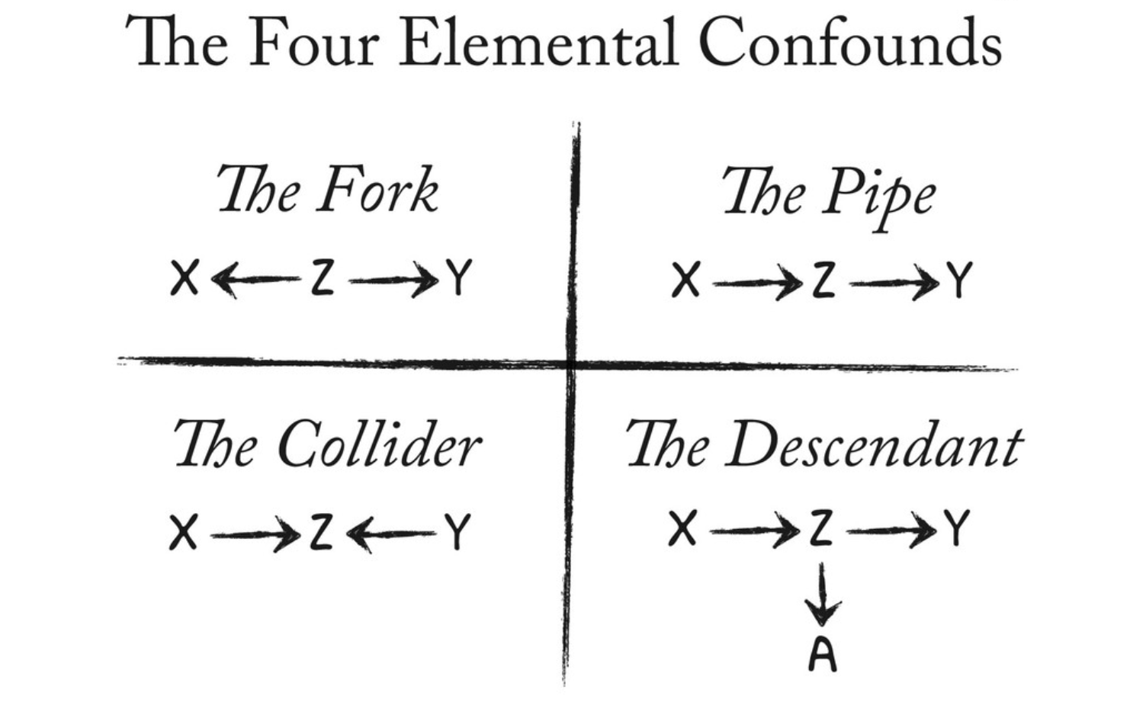
Let’s define this better
https://speakerdeck.com/rmcelreath/l06-statistical-rethinking-winter-2019?slide=10

Slide 15
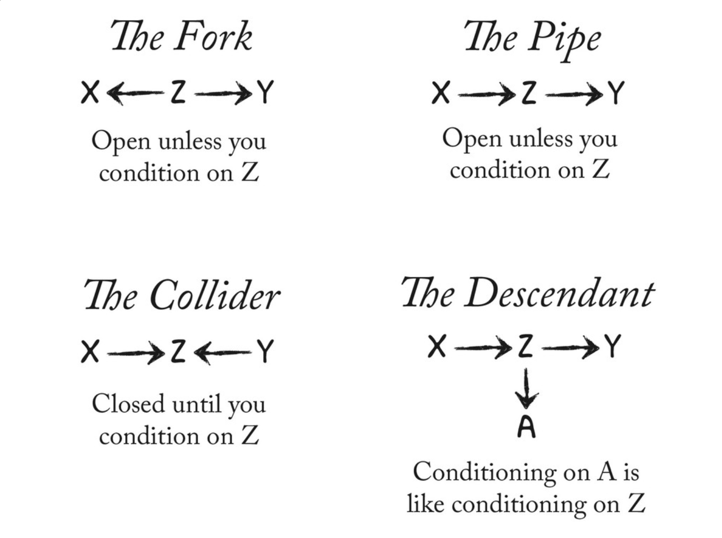

Slide 16
Potential Outcomes
Another way to think about causation is the difference between:
the outcome from a change in the predictor
what the outcome would have been without the change
vs

Slide 17
Potential Outcomes
How can we know what the outcome would have been without the intervention??
Health after starting to exercise
Health
What health would be without exercise
Time

Slide 18
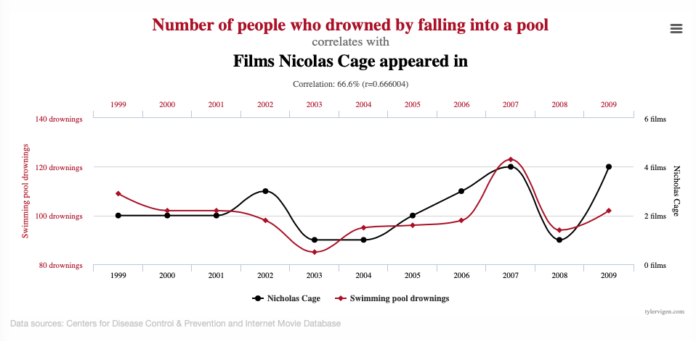
What happens when we don’t pay attention to causation
https://www.tylervigen.com/spurious-correlations

Slide 19
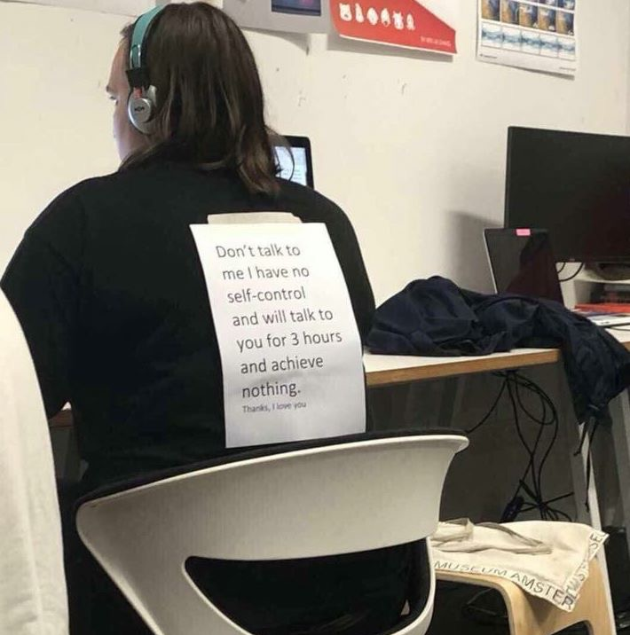
“Thanks. I love you.”

